Slide 1
THE DYNAMIC MARKETS MODEL, APPLIED
Buying the Past
The Acquisition Risk Nobody's Diligence Examines
Mike Edholm

Slide 2
THE PROBLEM
Standard diligence audits the company.
Nobody audits the layer.
70–90%
1 question
of acquisitions fail to deliver their expected returns, per a widely cited Harvard Business Review estimate. Overpayment, culture clash, and integration failure are the standard explanations — and all are real.
that no workstream owns: is the target's layer still where value is accumulating — or a layer value has already begun to leave? This deck applies one framework to answer it, case by case.
BUYING THE PAST
THE DYNAMIC MARKETS MODEL, APPLIED

Slide 3
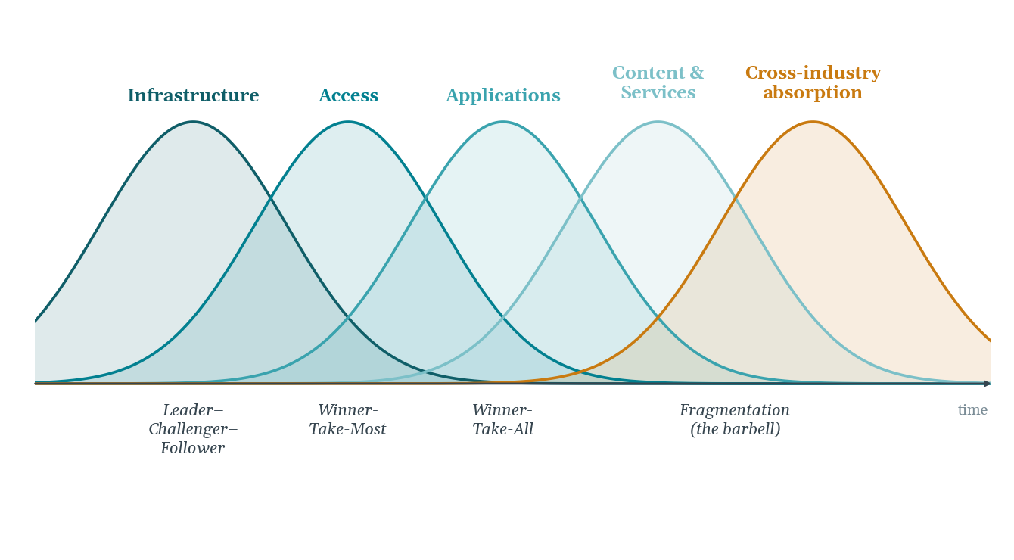
THE FRAMEWORK
The Dynamic Markets Model
Five overlapping diffusion curves, each capturing a different set of companies. The fifth curve, in amber, is the author's extension.
BUYING THE PAST
THE DYNAMIC MARKETS MODEL, APPLIED

Slide 4
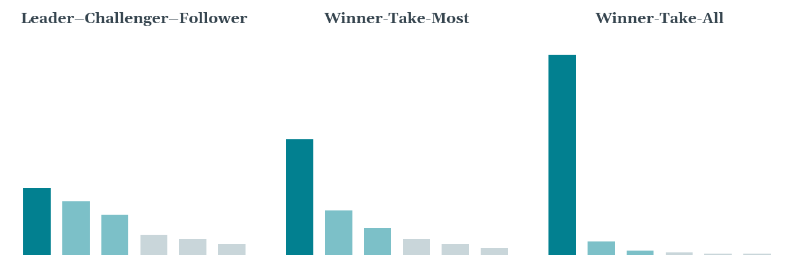
THE FRAMEWORK
Three Recurring Market Structures
Shown as market-share profiles. The taxonomy describes the shape of competition, not the identity of the competitors.
BUYING THE PAST
THE DYNAMIC MARKETS MODEL, APPLIED

Slide 5
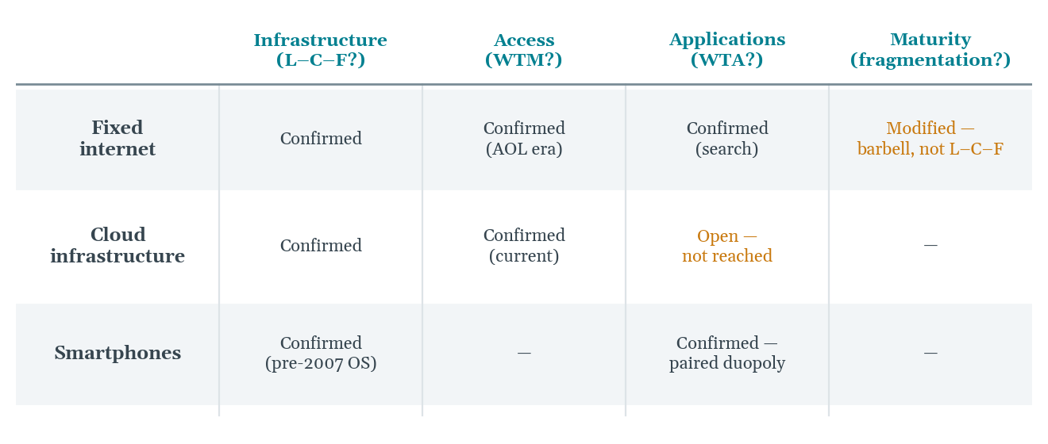
THE FRAMEWORK
The Model Against Documented History
Three transitions, checked stage by stage. The amber cells are the point — complications reported alongside confirmations.
BUYING THE PAST
THE DYNAMIC MARKETS MODEL, APPLIED

Slide 6
THE COMMERCIAL APPLICATION
The same model, run on the biggest decisions
companies make
A buyer paying growth prices for a position in a layer already past its peak is not a pricing mistake. It's a diagnosis the model already predicts.
BUYING THE PAST
THE DYNAMIC MARKETS MODEL, APPLIED

Slide 7
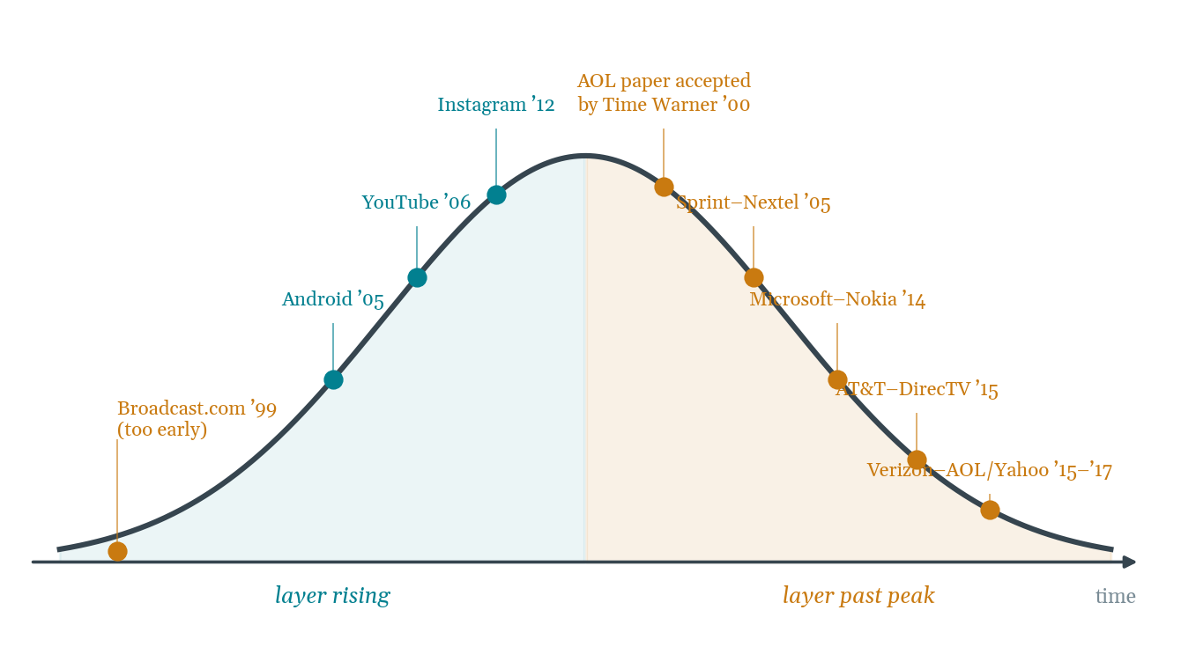
THE PATTERN
Acquisitions on the Target Layer's Curve
Teal buys purchased layers still rising; amber buys paid growth prices at or past the peak.
BUYING THE PAST
THE DYNAMIC MARKETS MODEL, APPLIED

Slide 8
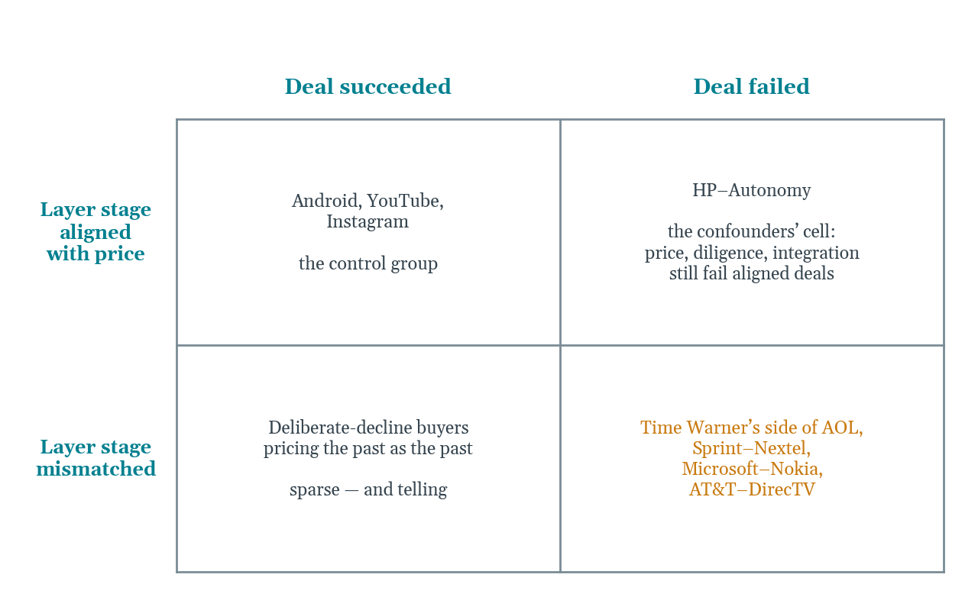
THE TEST
The Four-Cell Test
A framework that only explained the lower-right cell would be hindsight. The claim stands or falls on filling all four.
BUYING THE PAST
THE DYNAMIC MARKETS MODEL, APPLIED

Slide 9
THE CASE LIBRARY
Ten deals, one signature
Each card below places one acquisition against its own layer's diffusion curve — teal where the stage was aligned, amber where it wasn't. Built to grow: as new deals close, a new card slots in using the same four fields.

Slide 10
LAYER MISMATCHED · FAILED
AOL → Time Warner
2000
THE SIGNAL
DEAL SIZE
Dial-up subscriber growth was decelerating and broadband adoption was rising — both fully public before the deal closed.
$165B
OUTCOME, IN NUMBERS
THE OUTCOME
~$99B written down (2002)
The largest annual corporate loss in American history at the time: the delayed accounting acknowledgment of a repriced layer.
BUYING THE PAST
CASE LIBRARY

Slide 11
LAYER MISMATCHED · FAILED
Yahoo → Broadcast.com
1999
THE SIGNAL
DEAL SIZE
The right layer, streaming media — bought roughly a decade before the broadband and compression infrastructure existed to carry it.
$5.7B
OUTCOME, IN NUMBERS
THE OUTCOME
Shut down within ~3 years
Quietly discontinued once the enabling layers beneath it failed to mature in time. Too early is the same error as too late, sign reversed.
BUYING THE PAST
CASE LIBRARY

Slide 12
LAYER MISMATCHED · FAILED
Sprint → Nextel
2005
THE SIGNAL
DEAL SIZE
Two positions in a network-access layer already heading into commoditization.
$37.8B
OUTCOME, IN NUMBERS
THE OUTCOME
~$30B written down (2008)
Written down within about three years; the merged network technologies never integrated cleanly either.
BUYING THE PAST
CASE LIBRARY

Slide 13
LAYER MISMATCHED · FAILED
Microsoft → Nokia Devices
2014
THE SIGNAL
DEAL SIZE
A position in device hardware, years after value had migrated to the platform layer above it.
~$7.2B
OUTCOME, IN NUMBERS
THE OUTCOME
~$7.6B written off (2015)
Written off almost in full within about fifteen months — the fastest reversal in the set.
BUYING THE PAST
CASE LIBRARY

Slide 14
LAYER MISMATCHED · FAILED
AT&T → DirecTV
2015
THE SIGNAL
DEAL SIZE
The leading position in linear satellite television, acquired almost exactly as streaming began repricing the entire layer.
$48.5B
OUTCOME, IN NUMBERS
THE OUTCOME
Spun off at $16.25B (2021)
Spun off six years later at roughly a third of the purchase price.
BUYING THE PAST
CASE LIBRARY

Slide 15
LAYER MISMATCHED · FAILED
Verizon → AOL & Yahoo
2015–17
THE SIGNAL
DEAL SIZE
Positions in the web-portal and digital-advertising layer, acquired after its economics had already concentrated around two platform winners.
$8.9B combined
OUTCOME, IN NUMBERS
THE OUTCOME
Sold to private equity for ~$5B (2021)
Written down within eighteen months, then sold at roughly half of what Verizon paid.
BUYING THE PAST
CASE LIBRARY

Slide 16
LAYER ALIGNED · SUCCEEDED
Google → Android
2005
THE SIGNAL
DEAL SIZE
An application-layer bet made early on that layer's own curve, years before its value was obvious to the market.
~$50M
OUTCOME, IN NUMBERS
THE OUTCOME
Now the world's leading mobile OS
Attacked as a puzzling purchase at the time. The layer's growth was, in fact, still ahead of it — the control group in this argument.
BUYING THE PAST
CASE LIBRARY

Slide 17
LAYER ALIGNED · SUCCEEDED
Google → YouTube
2006
THE SIGNAL
DEAL SIZE
The same pattern: an early position in a layer still rising, priced against a future that hadn't arrived yet.
$1.65B
OUTCOME, IN NUMBERS
THE OUTCOME
Now a core pillar of Alphabet's ad business
Widely called overpayment at announcement. The layer's growth curve proved the price right.
BUYING THE PAST
CASE LIBRARY

Slide 18
LAYER ALIGNED · SUCCEEDED
Facebook → Instagram
2012
THE SIGNAL
DEAL SIZE
An early, rising-layer purchase, priced years ahead of the mobile-photo-sharing curve's peak.
~$1B
OUTCOME, IN NUMBERS
THE OUTCOME
Now a primary growth engine for Meta
Called an excessive number for a 13-person company at the time. The curve since has said otherwise.
BUYING THE PAST
CASE LIBRARY

Slide 19
LAYER ALIGNED · FAILED
HP → Autonomy
2011
THE SIGNAL
DEAL SIZE
The target's layer was not past its peak. This failure came from price, diligence, and alleged accounting irregularities — not stage.
$11.1B
OUTCOME, IN NUMBERS
THE OUTCOME
~$8.8B written down (2012)
The case that keeps the framework honest: layer alignment is necessary-leaning, not sufficient, for a deal to succeed.
BUYING THE PAST
CASE LIBRARY

Slide 20
THE DIAGNOSTIC
The Acquisition Test
Four questions, run before a term sheet, using only public data.
1
Where does the layer sit?
Capital expenditure, price direction, switching-cost trend, and competitor count — relative to the layer's own history, not the target's.
2
Does the price assume the future or the past?
Growth multiples applied to a layer whose markers have turned are the precise signature of buying the past at future prices.
3
What does the seller know that the price doesn't?
A controlling shareholder converting equity at the top of their layer's curve is information, not noise.
4
Is the enabling infrastructure actually in place?
The mirror check for early buyers: the right layer, purchased before its curve has begun, is not early. It is stationary.
BUYING THE PAST
THE DYNAMIC MARKETS MODEL, APPLIED

Slide 21
CONCLUSION
Buying the past is not the error.
Paying future prices for it is.
BUYING THE PAST · Mike Edholm · edholms.com

