Slide 1
SCENARIO PLANNING METHODOLOGY SERIES
The Dynamic Markets Model
Where Value Goes as a Technology Grows Up
Mike Edholm

Slide 2
THE QUESTION
Value in a technology market does not stay where it first appears
It moves, in a sequence regular enough to plot, through five overlapping stages — each one handing the industry's center of gravity to a different set of companies than the one before it.
THE DYNAMIC MARKETS MODEL
SCENARIO PLANNING METHODOLOGY SERIES

Slide 3
THE ORIGIN
A hotel ballroom in Scottsdale,
an analyst who stopped at four
Infrastructure, access, applications, content and services — tidy, complete, and one stage short. The gap was not a flaw in her analysis. It was a boundary around what her analysis was for.
THE DYNAMIC MARKETS MODEL
SCENARIO PLANNING METHODOLOGY SERIES

Slide 4
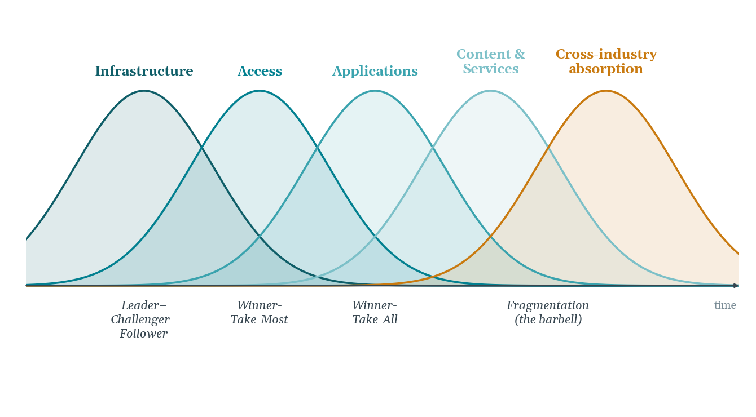
THE MODEL
The Dynamic Markets Model
Five overlapping diffusion curves, each capturing a different set of companies. The fifth curve, in amber, is the extension the Scottsdale presentation stopped short of.
THE DYNAMIC MARKETS MODEL
SCENARIO PLANNING METHODOLOGY SERIES

Slide 5
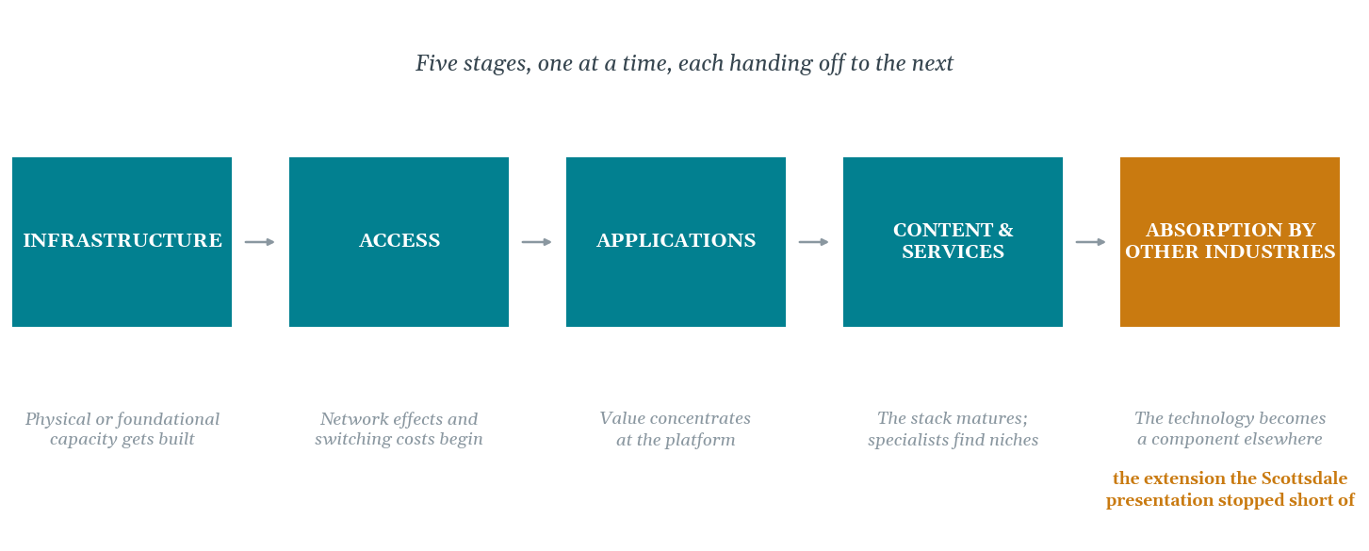
NAMED PLAINLY
The Five Stages
Four of these were already visible to any competent industry analyst by the late 1990s. The fifth was not.
THE DYNAMIC MARKETS MODEL
SCENARIO PLANNING METHODOLOGY SERIES

Slide 6
CREDIT WHERE DUE
Two other frameworks overlap —
and both are worth naming
Red Hat's overlapping S-curves
Grant & Grossman's apps-infrastructure cycle
A newer technology's rise beginning while an older one is still near its peak. A different question — which technology displaces the other, not which company captures value within one technology's own five stages.
Applications and infrastructure perpetually begetting each other across full technology epochs. A different resolution — this model works within a single epoch's five stages, not across many.
THE DYNAMIC MARKETS MODEL
SCENARIO PLANNING METHODOLOGY SERIES

Slide 7
LEFT OPEN, ON PURPOSE
Knowing where value goes is not
the same as knowing the shape of the fight
Are there many viable competitors at a given stage, a handful, or effectively one? That is a genuinely separate question, with its own mechanism and its own historical testing — and it deserves its own treatment rather than a rushed answer appended to this one.
THE DYNAMIC MARKETS MODEL
SCENARIO PLANNING METHODOLOGY SERIES

Slide 8
IN PRACTICE
Locating a Stage From the Inside
Four markers, checkable in real time, not just in hindsight.
1
2
3
4
Where the capital is concentrating
The onset of network effects and switching costs
The count of viable generalists
The direction of price movement
Heavy, rising investment in physical or foundational capacity signals the infrastructure stage — visible in spending data before it shows up in strategy documents.
When customers begin to find leaving harder than staying, the shift to access has already begun, whether market-share numbers reflect it yet or not.
Tracked over time, not checked once. A falling count is consolidation in progress; a stable count is a stage that has matured.
A layer that recently commanded premium pricing, now seeing steep, sustained declines, is signaling its stage has peaked and value is moving up the stack.
THE DYNAMIC MARKETS MODEL
SCENARIO PLANNING METHODOLOGY SERIES

Slide 9
CONCLUSION
Four stages everyone could see.
One nobody was paid to look for.
A technology that has finished consolidating within its own industry does not stop there. It becomes an input other industries build on top of, without needing to think of it as technology at all.
NEXT IN THIS SERIES
Borrowed Time
THE OPAQUE SURPRISE · Mike Edholm · edholms.com

