Slide 1
SCENARIO PLANNING METHODOLOGY SERIES
AI’s Four Shakeouts
Each Layer Sorts on the Schedule Its Own Capital Allows
The question is not whether. It is how long, layer by layer.
Mike Edholm
AI'S FOUR SHAKEOUTS
SCENARIO PLANNING METHODOLOGY SERIES

Slide 2
THE QUESTION
Not Whether, but How Long
Everyone agrees a shakeout is coming
Thousands of companies have been funded against a market that will not support thousands of companies. That much is agreed, and agreement on it settles nothing that matters.
How long the sorting takes decides the strategy for everyone inside the industry and everyone lending to it, and how to read the news.
The chip layer is already concentrated. Applications may churn for years. Infrastructure could endure the longest period of all.
Three years or twenty-five: opposite strategies
A 30% drop in two weeks: sorting or repricing?
Not one shakeout, on one timetable
AI will not undergo one shakeout. It will undergo four, on four schedules.
AI'S FOUR SHAKEOUTS
SCENARIO PLANNING METHODOLOGY SERIES

Slide 3
THE MECHANISM
Two Conditions
The divergence condition
The exit condition
Someone has to pull decisively clear.
Governed by increasing returns: scale economies, network effects, installed base, the compounding advantage of the firm that already produces most and knows most.
Strong returns: leaders separate quickly. Weak returns: nobody makes continuing look hopeless.
Then the losers have to go.
Governed by whether the capital they committed can be sold to anyone outside their own trouble.
The neglected half, largely left alone by the literature on shakeouts.
A shakeout ends when the field settles into the small set of names that will hold it. Getting there takes both.
Exit is why the same shock can take three years to settle in one industry and thirty in another.
AI'S FOUR SHAKEOUTS
SCENARIO PLANNING METHODOLOGY SERIES

Slide 4
THE DEFINITION
Portable and Anchored
Portable
A buyer outside the industry’s difficulty will pay something close to what it cost.
Anchored
Its worth depends on the position that created it. Prizing it out destroys most of the value.
A vineyard
An airline’s slots
An installed base
Heavy, immobile, and portable. Land and winery find buyers whether or not this producer survives.
Weigh nothing, and are anchored absolutely: their value comes from the carrier’s network.
Costs enormous sums and is worth nothing to a rival. A sale cannot carry the relationship across.
Size has nothing to do with it, and neither does whether the asset can physically be moved.
AI'S FOUR SHAKEOUTS
SCENARIO PLANNING METHODOLOGY SERIES

Slide 5
THE TEST
Four Indicators, Dated at the Peak
1
A secondary market price?
Did a secondary market publish prices for the industry’s principal asset?
2
Lending that survived?
Did lenders advance against it at a real rate, and did that survive the downturn?
3
Buyers from outside?
Did purchasers of exiting firms’ assets come from outside the industry, or only from rivals?
4
Plant turned to other uses?
Was the plant ever documented as turned to another product?
Three or four yes: portable. Zero or one: anchored. Two: the test makes no prediction.
All four ask one question: was there a buyer who was not himself a distressed rival?
AI'S FOUR SHAKEOUTS
SCENARIO PLANNING METHODOLOGY SERIES

Slide 6
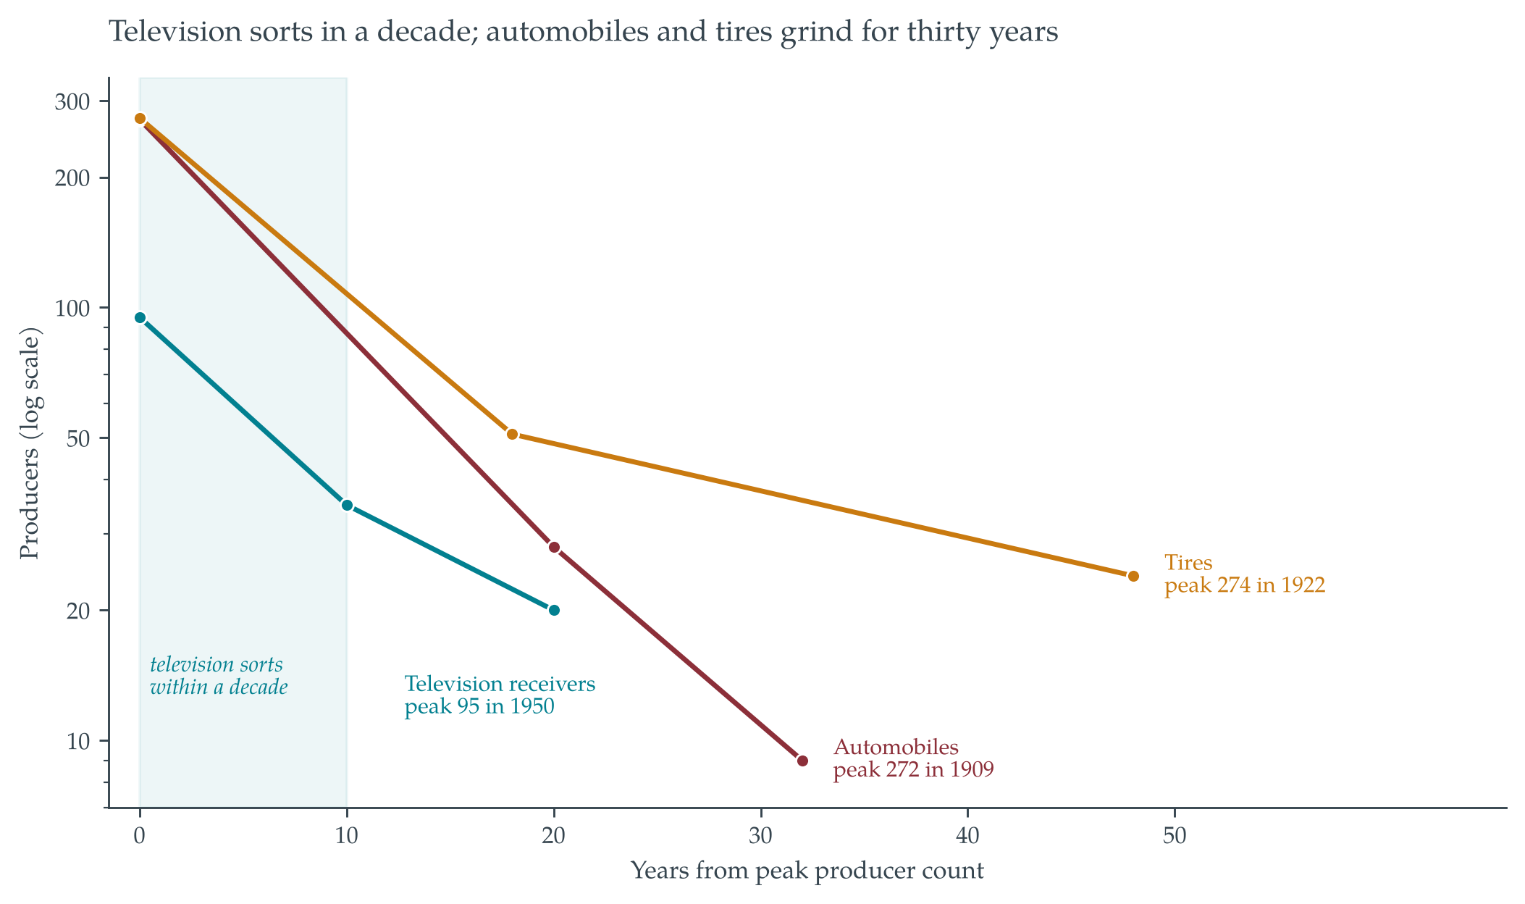
THE RECORD
Television Sorts in a Decade
Television receivers
Radio makers’ assembly capacity moved between products. Portable capital, strong returns.
Automobiles and tires
Plant, dies and molds worth scrap to anyone else. Buyers were rivals in the same difficulty.
Same era, comparable shocks. One sorted in ten years, the others ground on for thirty.
AI'S FOUR SHAKEOUTS
SCENARIO PLANNING METHODOLOGY SERIES

Slide 7
THE EXCEPTION
Portable, and Still the Slowest
63%
6%
70%
3%
Television producers lost in the decade after 1950
Automobile exits that came through acquisition
Penicillin producers lost, but across three decades
Penicillin exits that came through acquisition
Fermentation capacity runs other antibiotics and other products, so penicillin’s capital was portable and exit was available. Yet nobody pulled decisively clear: the product commoditized and divergence never really started.
Cheap, optional exit produces attrition rather than a sorting. The PC transition shows the same at layer level: chips and operating systems settled in a decade, assembly ran twenty-five years.
Portability alone predicts the opposite. Both conditions are needed.
AI'S FOUR SHAKEOUTS
SCENARIO PLANNING METHODOLOGY SERIES

Slide 8
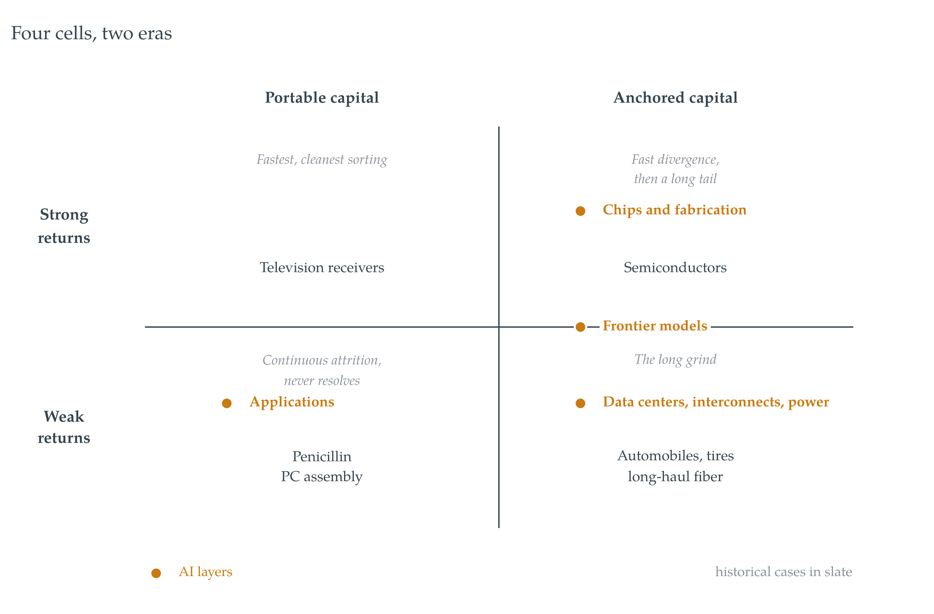
THE STACK
AI’s Four Layers, Four Cells
Chips and fabrication
Anchored, strong returns. Divergence largely complete.
Data centers, interconnects, power
Anchored, weak returns. The long grind, where fiber sat after 2001.
Frontier models
Anchored, returns on the boundary. The placement most likely to be wrong.
Applications
Portable, weak returns. Continuous attrition, unless a submarket finds returns.
The layer making the headlines has nearly finished sorting. The layer carrying the capital has barely started.
AI'S FOUR SHAKEOUTS
SCENARIO PLANNING METHODOLOGY SERIES

Slide 9
THE DIAGNOSTIC
What to Watch
1
Which layer?
Stop asking whether the AI shakeout has started. Ask which layer, and what happens to the losers’ capital.
2
Utilization, not share prices
Falling prices while capital is still committed is a buildout repricing. Idle capacity while capital withdraws is a sorting.
3
Each layer’s own exit rate
The layers sort on separate schedules. A single industry-wide verdict will be wrong about at least one.
4
Who buys this if we are wrong?
And at what fraction of cost? A rival, at scrap, means years of defending rather than selling.
The weakest joint: the layers may not stay separate. Integration would merge their schedules.
Recognition has accelerated. Construction has not.
AI'S FOUR SHAKEOUTS
SCENARIO PLANNING METHODOLOGY SERIES

Slide 10
CONCLUSION
The signal can travel at whatever speed markets move at.
The concrete cannot.
Anchored capital cannot leave quickly. The losses stay with whoever financed it, and the assets stay to be used by somebody else.
AI’S FOUR SHAKEOUTS · Mike Edholm · edholms.com

