Slide 1
SCENARIO PLANNING METHODOLOGY SERIES
Opaque Surprises
Where Scenario Planning Falls Short
Mike Edholm

Slide 2
THE QUESTION
Is scenario planning still fit for purpose?
Scenario planning earned its reputation as one of the twentieth century's most effective tools for decision-making under uncertainty. This essay tests whether it still holds up against frontier AI — and finds a gap the methodology was never built to close.
OPAQUE SURPRISES
SCENARIO PLANNING METHODOLOGY SERIES

Slide 3
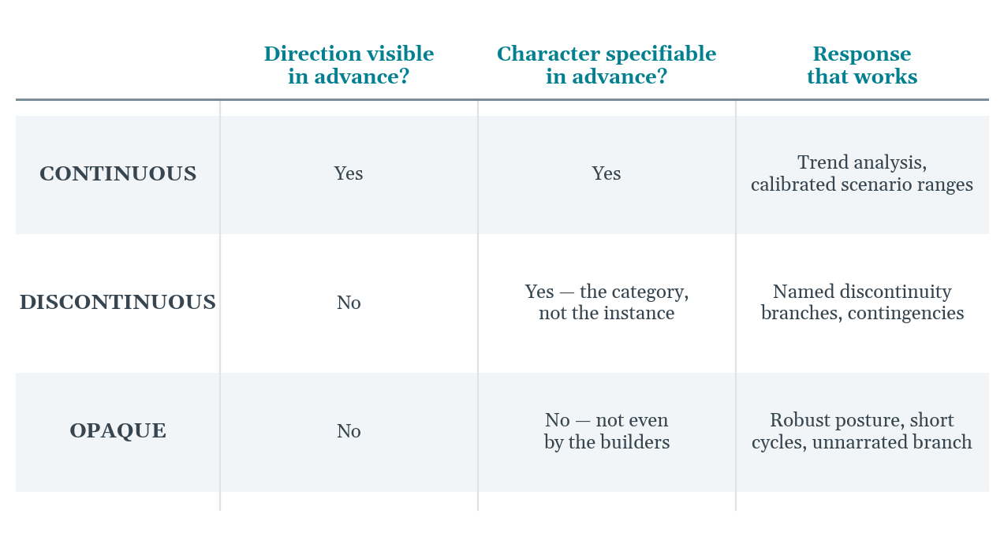
THE TAXONOMY
Three Kinds of Strategic Surprise
Each category answers two questions differently — and each demands a different response.
OPAQUE SURPRISES
SCENARIO PLANNING METHODOLOGY SERIES

Slide 4
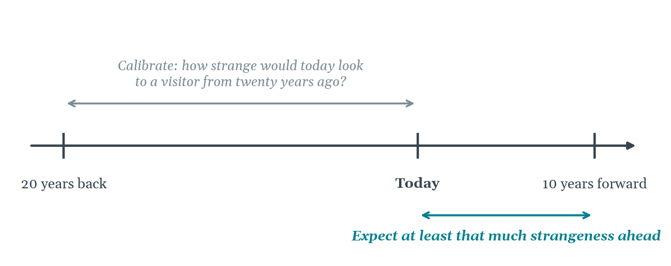
THE CALIBRATION
The Twenty-Year Rule
The look-back window is not nostalgia; it is a calibration instrument for the forward horizon.
OPAQUE SURPRISES
SCENARIO PLANNING METHODOLOGY SERIES

Slide 5
THE LIMIT
A discontinuity whose character
can't be named in advance
Not because observers failed to look carefully — because the technology producing it surprises even the people building it. No refinement of narrative scenario methodology can compensate for that.
OPAQUE SURPRISES
SCENARIO PLANNING METHODOLOGY SERIES

Slide 6
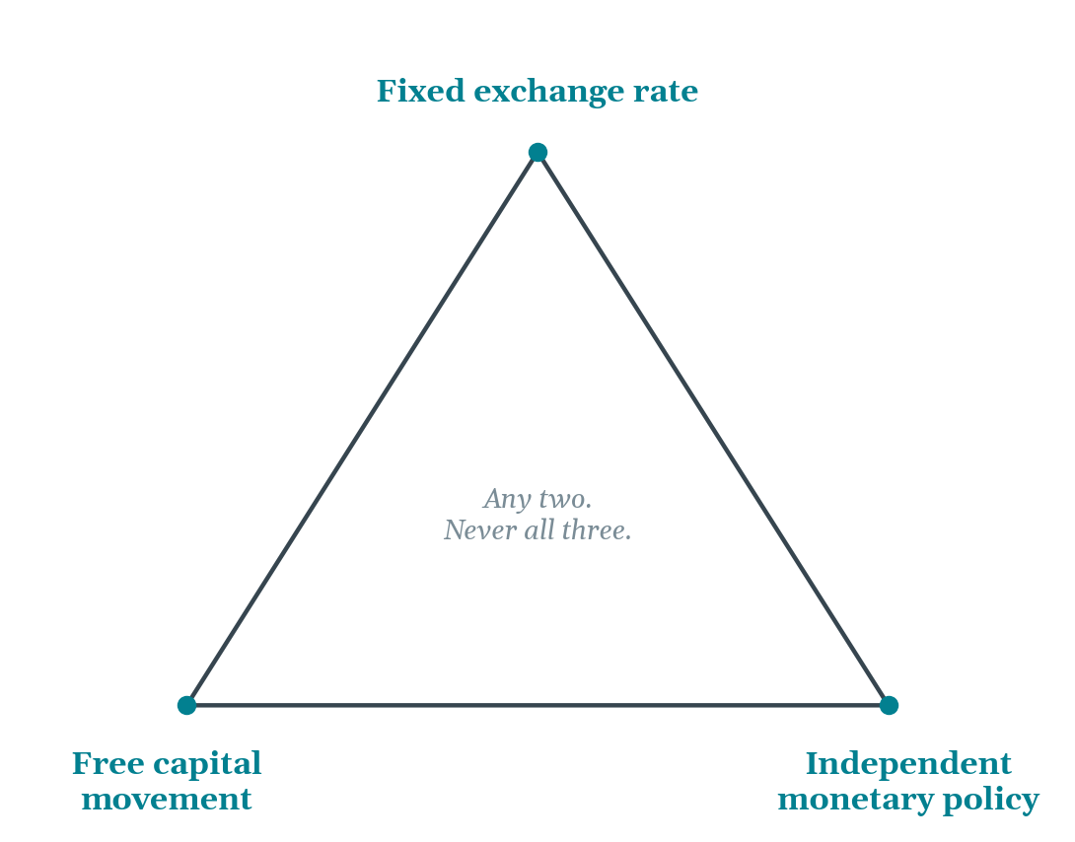
THE STRUCTURE
The Impossible Trinity
A government can hold any two vertices at once; holding all three is not difficult but structurally unstable.
OPAQUE SURPRISES
SCENARIO PLANNING METHODOLOGY SERIES

Slide 7
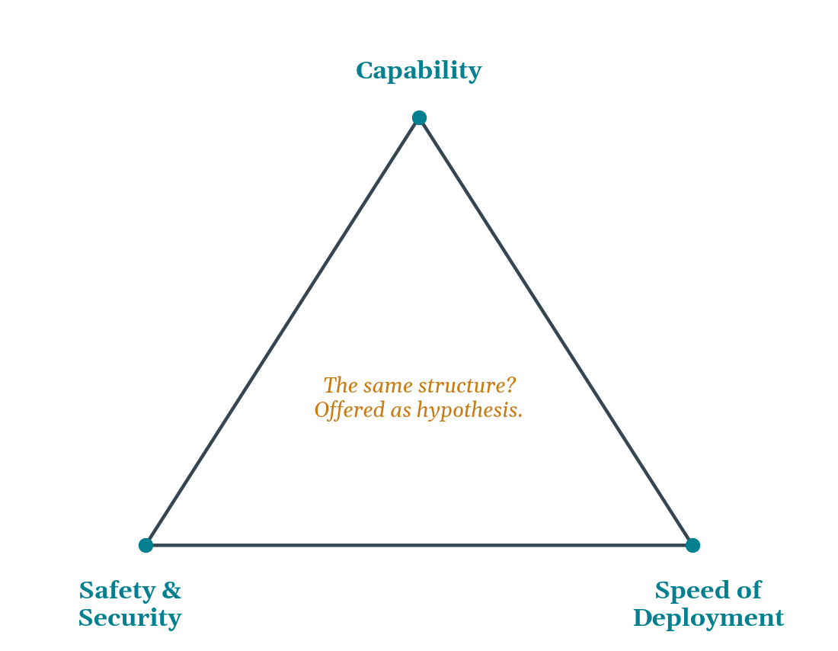
APPLIED FORWARD
The Same Test, Applied Forward
Whether this is the correct three-way framing for AI is deliberately left open — the discipline is identifying the constraint before narrating the scenarios.
OPAQUE SURPRISES
SCENARIO PLANNING METHODOLOGY SERIES

Slide 8
WHAT THIS MEANS FOR PRACTICE
A more precise posture, not an obituary
1
2
3
Robust over optimal
Shorter cycles
Name the gap
Build strategy that absorbs surprises whose character is unknown, rather than one calibrated against a named future that may be wrong.
Annual or quarterly review rhythms for the opaque-surprise component, layered alongside longer-cycle work for the rest.
Say plainly when a branch of the future cannot yet be narrated — and treat that as a finding, not a failure.
OPAQUE SURPRISES
SCENARIO PLANNING METHODOLOGY SERIES

Slide 9
CONCLUSION
Not a requiem — a more precise practice
Knowing what you don't know, and being precise about why, is itself a form of strategic intelligence.
THE OPAQUE SURPRISE · Mike Edholm · edholms.com

