Slide 1
SCENARIO PLANNING METHODOLOGY SERIES
The Two Clocks
Why Zero-Sum Behavior Is Usually Correct
Zero-sum is not an attitude. It's a duration.
Mike Edholm
THE TWO CLOCKS
SCENARIO PLANNING METHODOLOGY SERIES

Slide 2
THE PROBLEM
A Queue Nobody Can Expand
Interconnection queue: 4 to 7 years
A data center campus that joined the utility queue in Northern Virginia, Phoenix or Dallas this year waits years for power. The capital is committed. The construction is unremarkable.
So the operators are not competing for money, and not for silicon. They compete for position in a queue, and every position one takes is a position another cannot have.
Watch how that gets described. Hoarding. Land grab. Winner-take-all. The vocabulary implies a failure of character, and the implied remedy is cooperation.
Large power transformer: about 3 years
Largest high-voltage units: about 4 years
GPU allocation: reassigned in months
But there is nothing to cooperate about. Inside a queue with a fixed clearing rate, share is the only variable there is.
THE TWO CLOCKS
SCENARIO PLANNING METHODOLOGY SERIES

Slide 3
THE DEFINITION
A Quantity, Not an Outlook
Zero-sum
A situation where the total is fixed, so whatever one party gains another loses. A claim about a quantity.
Zero-sum thinking
A disposition to treat every situation that way. A claim about a person. The two get run together constantly.
The interval
Trade is positive-sum over decades. The vessel capacity available in March 2021 was fixed. Both are true, and the interval is where people decide.
The argument here concerns the first. It is a claim about intervals, not about whole games.
THE TWO CLOCKS
SCENARIO PLANNING METHODOLOGY SERIES

Slide 4
THE MECHANISM
Two Clocks, Running at Different Speeds
The constraint clock
The decision clock
Fabs take 3 to 5 years. Container ships 2 to 3. Transformers and turbine slots longer, and the interconnection queue behind them longer still. Skilled labor runs 5 to 7 years and cannot be ordered at all.
These are not estimates or moods. They are engineering facts, and everyone in the industry knows them.
Board tenure. Budget cycles. Incentive plans. Ministerial terms. The patience of a capital market.
2 to 4 years, typically.
Shorter than the constraint, almost always, and nobody chose it that way.
When the decision clock runs shorter, the person allocating lives entirely inside the fixed-supply window. The expansion that would make the situation positive-sum arrives after they have left.
Zero-sum is not an attitude. It's a duration.
THE TWO CLOCKS
SCENARIO PLANNING METHODOLOGY SERIES

Slide 5
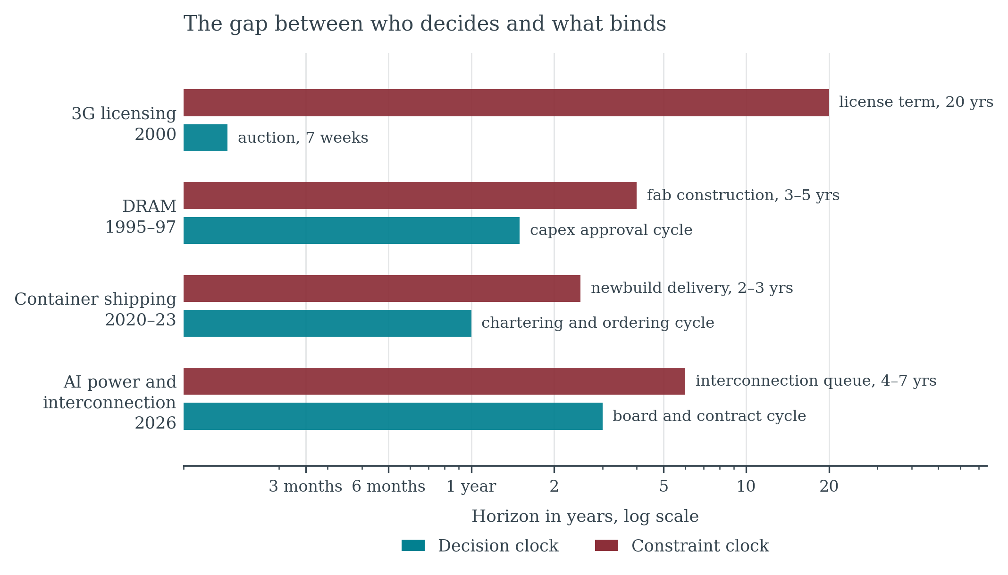
THE GAP
Who Decides, and What Binds
Four markets, four decades apart. In every one the constraint outlasts the decision-maker.
THE TWO CLOCKS
SCENARIO PLANNING METHODOLOGY SERIES

Slide 6
THE CASE
Wrong About the Calendar
$1,420
$10,377
30%
$1,479
Drewry composite, 2019 average, per forty-foot container
The same index at its peak, September 2021
Order book as a share of the existing fleet, late 2022
The index by September 2023, 86% below the peak
Inside the window, allocation was the whole game. Small importers could not outbid large ones for a slot. Carriers moved capacity onto premium lanes. Cargo that could not pay did not move. Nobody was being irrational or greedy — for roughly two years the supply of vessel capacity was fixed by physics.
Then the ships arrived. Between 2019 and 2023 the container fleet grew 21% while container volumes grew 4%.
Everyone was right about the shortage. Everyone was wrong about the calendar, and the calendar was set by the shipyards.
THE TWO CLOCKS
SCENARIO PLANNING METHODOLOGY SERIES

Slide 7
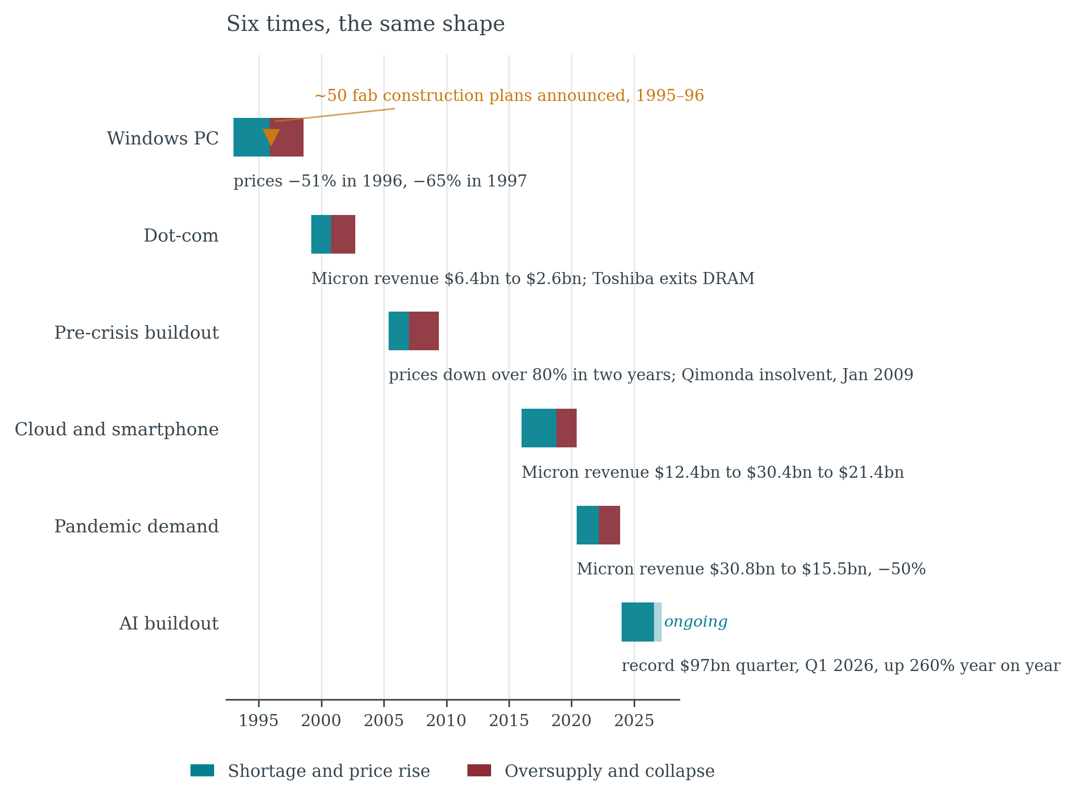
THE RECURRENCE
Six Times, the Same Shape
Memory has run this pattern for fifty years, with different people each time. Sophistication is not the variable.
THE TWO CLOCKS
SCENARIO PLANNING METHODOLOGY SERIES

Slide 8
THE EXPLANATION
Four Conditions
1
Commitment is irreversible
A half-built fab cannot be resold as a fab. Neither can a hull, or a substation.
2
The lead time is long and known
Everyone can say out loud that it takes three years.
3
The signal is public and simultaneous
The same price spike reaches every participant in the same week, through the same trade press.
4
Commitments are unobservable
Nobody can see what the others are ordering in time to adjust.
Where all four hold together, overshoot is not an error. It is the equilibrium.
The fight and the glut are the same fact, seen from inside and from outside.
THE TWO CLOCKS
SCENARIO PLANNING METHODOLOGY SERIES

Slide 9
THE DIAGNOSTIC
The Lead-Time Test, in Four Questions
1
What is the slowest physical constraint?
Usually not the one being discussed. In the AI buildout the conversation runs on chips, while the binding constraint is a transformer and a place in a queue.
2
How long is the decision horizon?
If it is shorter than the constraint, expect distributive conflict, and expect it to be rational.
3
Can the commitment be unwound?
Irreversible commitments convert a forecast into a fact on the ground, and the forecast was made at the least reliable moment.
4
Can participants observe each other?
If not, expect the overshoot however experienced they are. It is a property of the information structure, not of the people.
The depth test asks where an advantage lives. The trilemma test asks what a design gave up. This one asks how long a constraint has left to run.
All three turn an argument about motives into a question with an answer.
THE TWO CLOCKS
SCENARIO PLANNING METHODOLOGY SERIES

Slide 10
CONCLUSION
Scarcity does not end because people cooperate.
It ends because the lead time runs out.
Everything before that is allocation, and allocation is a fight.
THE TWO CLOCKS · Mike Edholm · edholms.com

